Slide 1
Diseases and Pests Identification of Lycium Barbarum Using SE-MobileNet V2
Algorithm
Mitheela das Armisha
23273003
Individual presentation

Slide 2
Introduction
Lycium barbarum is a solanaceae plant belonging to the genus lycium, which has precious medicinal value and is known as "red treasure".
The yield of lycium barbarum in Ningxia is easily affected by diseases and pests, climate, market price and other factors.
DATASET-
Total 1195 image including 11 kinds of medlar diseases and pests collecte
For sample 1870 spatial transformation and so on

Slide 3
Introduction(continued)
The aims of this research project-
to recognize the diseases and pests of lycium barbarum using lightweight Convolutional Neural Network: SE-MobileNet V2 image recognition algorithm
reduces the error of human identification and economic loss caused
farmers no longer need to master a lot of professional knowledge, they can identify pests by taking pictures to improve the control efficiency.

Slide 4
Methodology
These experiments are based on python with TensorFlow, set 10 types of pests and 1 type of disease pictures as data set which is established by manual acquisition and web crawler.
Carry out spatial transformation of some images,randomly change the brightness, sharpness, saturation and contrast of the images.
Add Gaussian noise to expand the image data set.

Slide 5
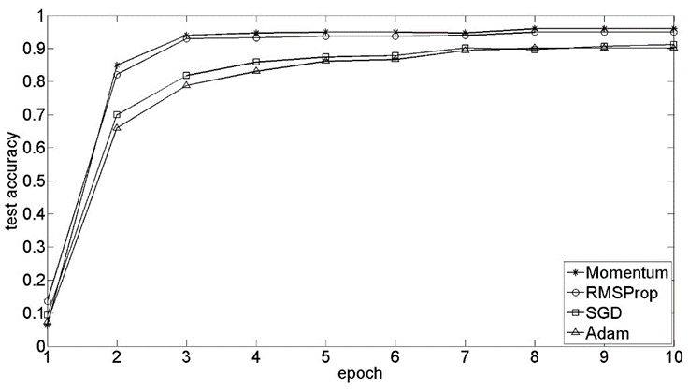
Methodology(continued)
Parameter Experiments
Momentum algorithm has the highest accuracy of 95.95% when iterating to the 10th epoch under the same hyper-parameter setting.

Slide 6
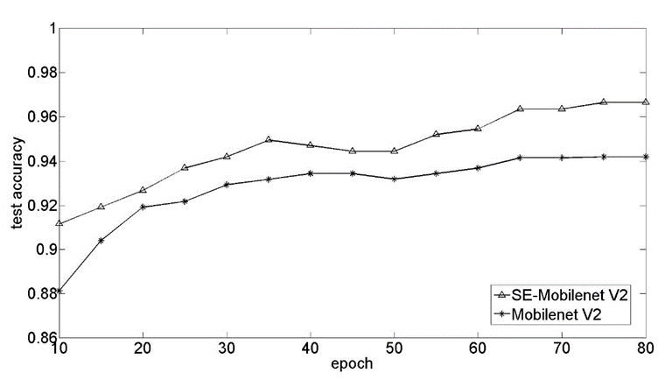
Model (SE-MobileNet V2)
the accuracy of MobileNet V2 can reach 90% after 14 epoch iterations, and that of the improved SE MobileNet V2 can reach 90% after 10 epoch iterations
the recognition accuracy of the original network is 94.19% and that of the improved network is 96.65%, which is 2.46% higher than that of the original network

Slide 7
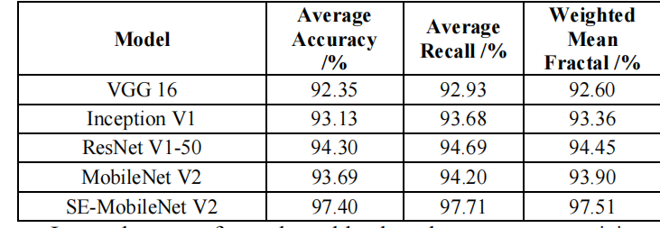
Model Comparison Experiments

Slide 8
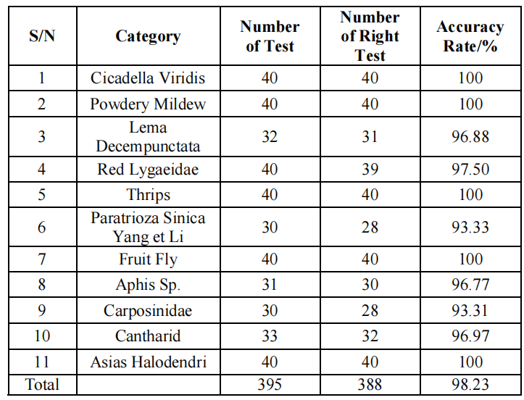
IMAGE TEST RESULTS OF 11 KINDS OF DISEASES AND
PESTS OF LYCIUM BARBARUM

Slide 9
Conclusion
SE-MobileNet V2 combines the advantages of MobileNet V2 and SENet, is more accurate than MobileNet V2 and is more suitable to recognize small target.
the improved algorithm has the highest recognition accuracy and strong robustness.
The algorithms proposed in this paper also bring reference value to image recognition cases in other fields.

